Slide 1
Week 5
BDA with Python

Slide 2
Introduction to Matplotlib - basic plots
Matplotlib is a popular Python library for creating static, animated, and interactive visualizations. It provides an interface similar to MATLAB and works well with NumPy and pandas.
Installing & Importing MatplotlibBefore using Matplotlib, install it (if not already installed):
install matplotlib
Then, import the necessary modules:
import matplotlib.pyplot as plt
import numpy as np

Slide 3
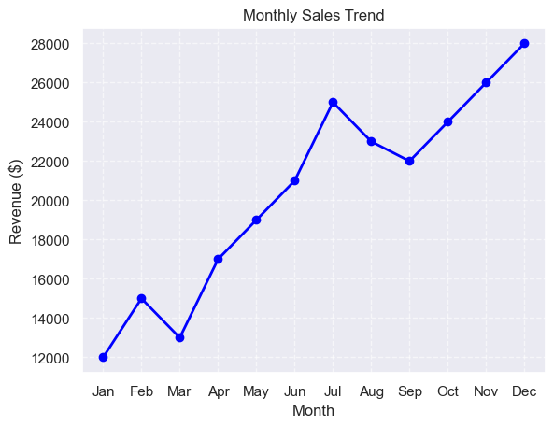

Slide 4
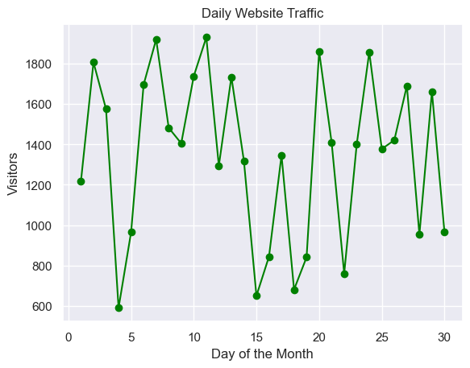

Slide 5
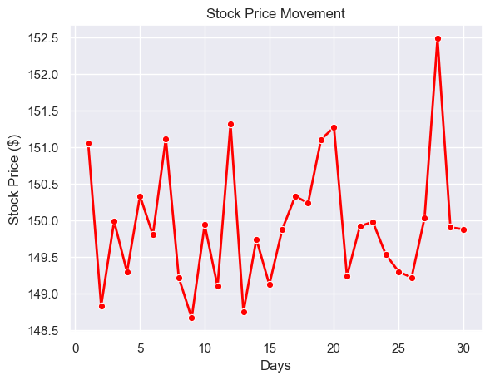

Slide 6
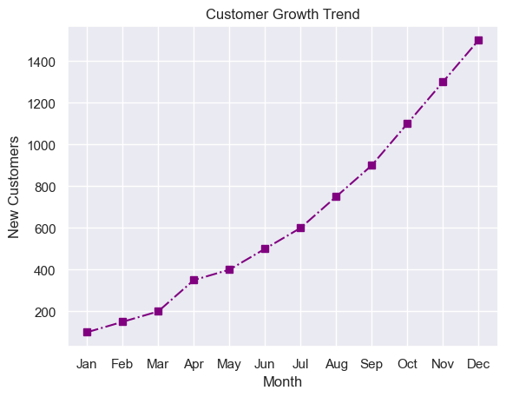

Slide 7
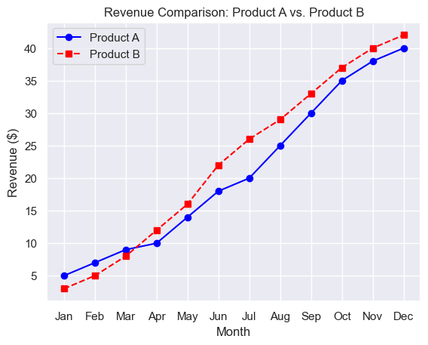

Slide 8
Basic Plots in Matplotlib – line plot
# Sample data
x = np.linspace(0, 10, 100) # Generates 100 values between 0 and 10
y = np.sin(x) # Compute sine of x
# Create plot
plt.plot(x, y, label="Sine Wave", color="blue", linestyle="--", linewidth=2)
# Add labels and title
plt.xlabel("X values")
plt.ylabel("Y values")
plt.title("Basic Line Plot")
plt.legend() # Display legend
# Show the plot
plt.show()

Slide 9
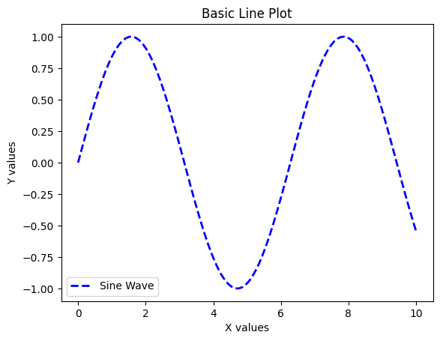
Basic Plots in Matplotlib – line plot

Slide 10
Basic Plots in Matplotlib – line plot
Key Functions Used:
plt.plot() → Creates the line
plot.plt.xlabel() & plt.ylabel() → Labels the axes.
plt.title() → Adds a title.
plt.legend() → Shows the legend.

Slide 11
plt.plot()
plt.plot(x, y, marker="o", markersize=8, markerfacecolor="red", markeredgecolor="black", markeredgewidth=2)
markersize=8: Increases the size of the markers.
markerfacecolor="red": Fills markers with red color.
markeredgecolor="black": Sets marker border color to black.
markeredgewidth=2: Adjusts the thickness of the marker border.
plt.plot(x, y, marker="s") # Square markers
plt.plot(x, y, marker="d") # Diamond markers
plt.plot(x, y, marker="x") # X-shaped markers
plt.plot(x, y, marker="*") # Star markers

Slide 12
plt.xlabel() & plt.ylabel()
plt.xlabel("X Axis", fontsize=14, color="blue", labelpad=10)
plt.ylabel("Y Axis", fontsize=14, color="red", labelpad=15)
fontsize=14: Adjusts the font size.
color="blue": Changes label color.
labelpad=10: Adds space between the label and the axis.

Slide 13
plt.title()
plt.title("Sine Wave Plot", fontsize=16, color="blue", pad=20, loc="left")
fontsize=16: Increases font size.
color="blue": Sets title color.
pad=20: Adds space between the title and the plot.
loc="left": Positions title on the left ("center" by default, "right" is also an option).

Slide 14
plt.legend()
plt.legend(loc="upper right", fontsize=12, title="Functions", frameon=True)
loc="upper right": Places the legend in the upper-right corner (other options: "upper left", "lower right", etc.).
fontsize=12: Adjusts the font size.
title="Functions": Adds a title inside the legend.
frameon=True: Displays a border around the legend (use False to remove it).

Slide 15
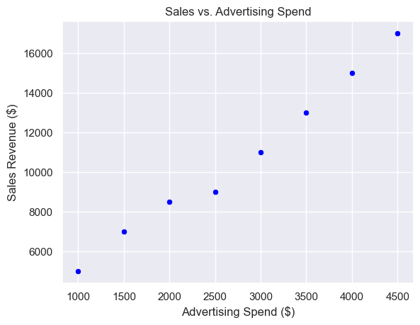
Scatter plot

Slide 16
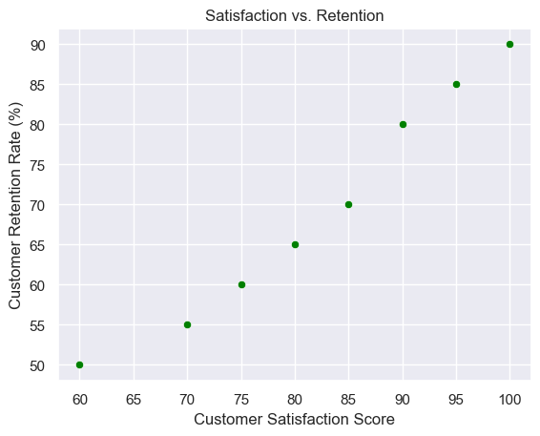
Customer satisfaction vs customer retention

Slide 17
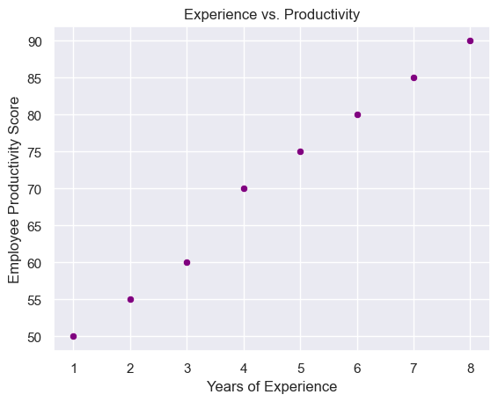
Employee experience vs productivity

Slide 18
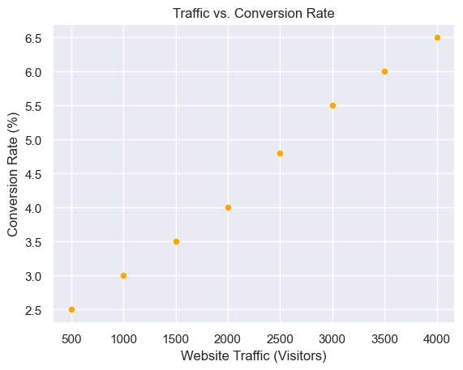
Website traffic vs conversion rate

Slide 19
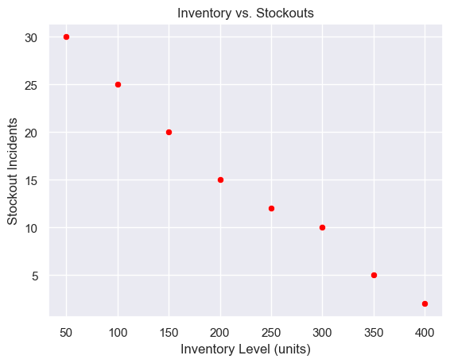
Inventory vs stockouts

Slide 20
Scatter Plot - visualizing relationships between two numerical variables
# Generate random data
x = np.random.rand(50) # 50 random values
y = np.random.rand(50)
# Create scatter plot
plt.scatter(x, y, color="red", marker="o", alpha=0.7)
# Labels and title
plt.xlabel("X values")
plt.ylabel("Y values")
plt.title("Basic Scatter Plot")
# Show the plot
plt.show()

Slide 21
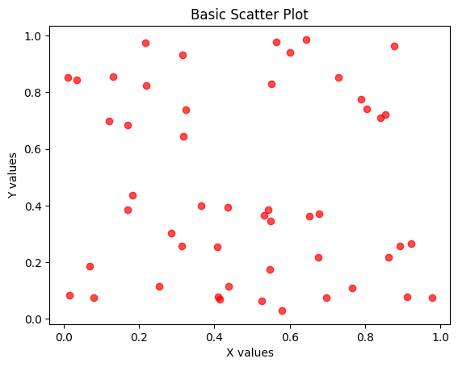
Scatter Plot - visualizing relationships between two numerical variables

Slide 22
Customizing scatter plot
plt.scatter(x, y, s=100, c="red", alpha=0.5, marker="o", edgecolors="black", linewidth=1.5)
s=100: Adjusts the marker size.
c="red": Sets the color to red.
alpha=0.5: Adds transparency (0 = fully transparent, 1 = fully opaque).
marker="o": Uses circle markers (you can change to "s" for squares, "^" for triangles, etc.).
edgecolors="black": Adds black borders to markers.
linewidth=1.5: Adjusts the border thickness.

Slide 23
Customizing scatter plot
colors = np.random.rand(50) # Random color values
plt.scatter(x, y, c=colors, cmap="viridis", s=100)
plt.title("Scatter Plot with Colormap")
plt.show()
c=colors: Assigns different colors to each point.
cmap="viridis": Uses the Viridis colormap (other options: "plasma", "coolwarm", "rainbow").
plt.colorbar(): Adds a color scale legend.

Slide 24
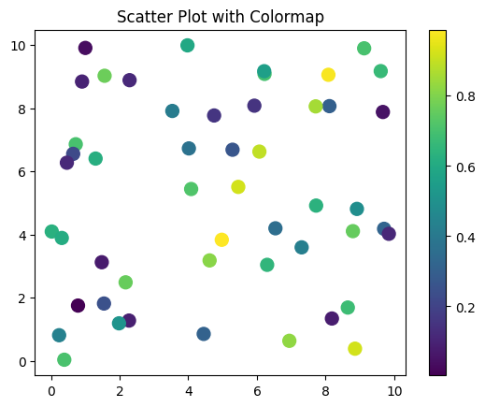
Output

Slide 25
Adding Labels to Points
for i in range(len(x)):
plt.text(x[i], y[i], f"({x[i]:.1f}, {y[i]:.1f})", fontsize=8)
plt.scatter(x, y, s=100, c="blue")
plt.title("Scatter Plot with Labels")
plt.show()
plt.text(x[i], y[i], "label"): Places text near each point.

Slide 26
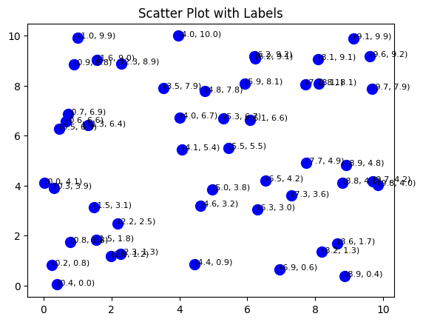
Output

Slide 27
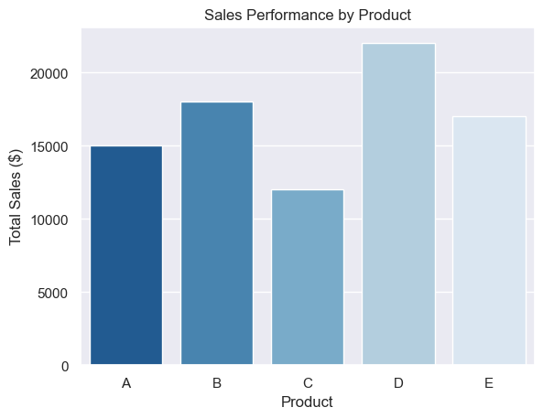
Bar charts – sales performance by product

Slide 28
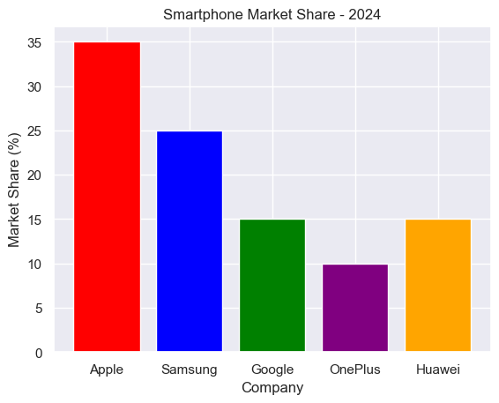
Smart phone market share by company

Slide 29
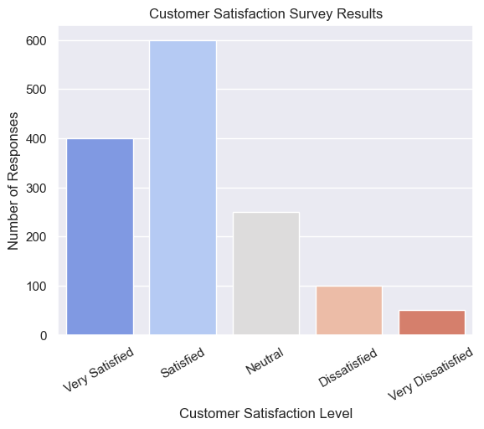
Customer servey

Slide 30
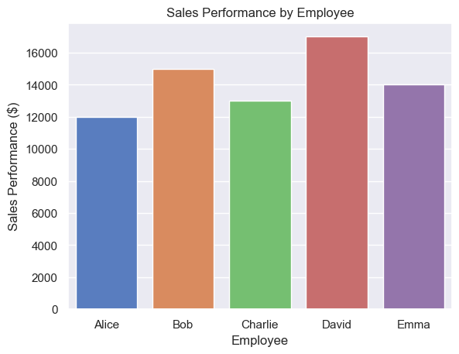
Employee performance comparison

Slide 31
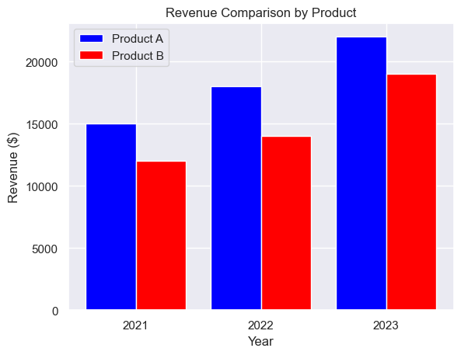
Advanced – product comparison by year

Slide 32
Bar Chart - to compare categorical data
# Data
categories = ["A", "B", "C", "D"]
values = [3, 7, 1, 8]
# Create bar chart
plt.bar(categories, values, color=["blue", "orange", "green", "red"])
# Labels and title
plt.xlabel("Categories")
plt.ylabel("Values")
plt.title("Basic Bar Chart")
# Show the plot
plt.show()

Slide 33
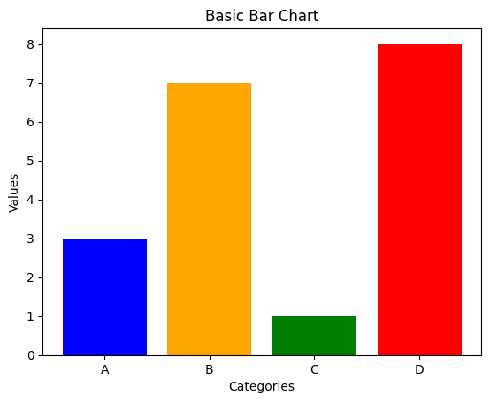
Bar Chart

Slide 34
Customizing Bar charts
Adding Edge Color & Line Width
plt.bar(categories, values, color="skyblue", edgecolor="black", linewidth=2)
edgecolor="black": Adds a black border around bars.
linewidth=2: Increases border thickness.

Slide 35
Displaying Values on Bars
bars = plt.bar(categories, values, color="lightblue")
# Add text on bars
for bar in bars:
plt.text(bar.get_x() + bar.get_width()/2, bar.get_height(), f"{bar.get_height()}",
ha="center", va="bottom", fontsize=12, fontweight="bold")
bar.get_x() + bar.get_width()/2: Positions text at the center of each bar.
bar.get_height(): Places text just above the bar.

Slide 36
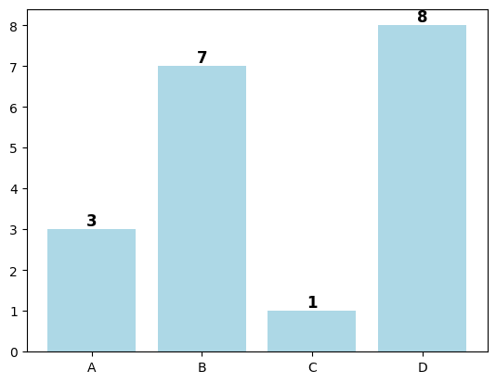

Slide 37
Horizontal Bar Chart
plt.barh(categories, values, color="lightcoral")
plt.xlabel("Values")
plt.ylabel("Categories")
plt.title("Horizontal Bar Chart")
plt.show()

Slide 38
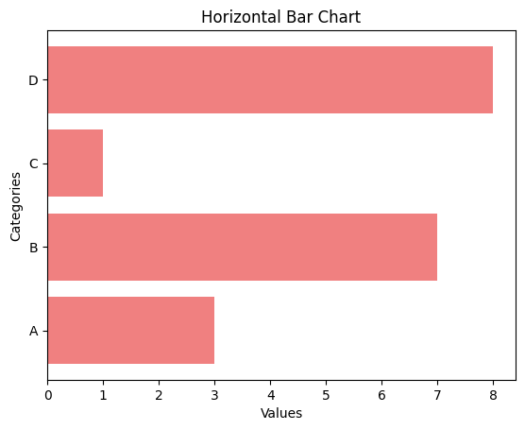

Slide 39
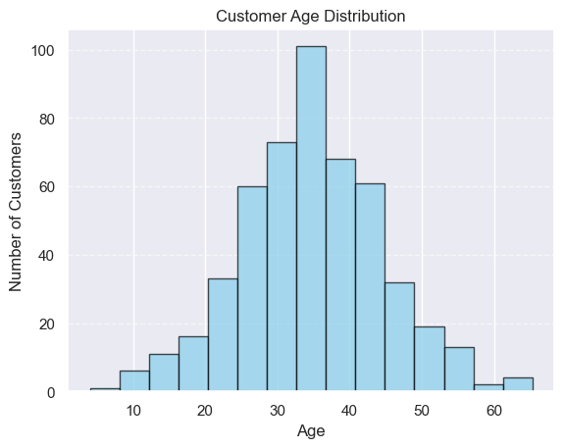
Histogram examples – Customer age distribution

Slide 40
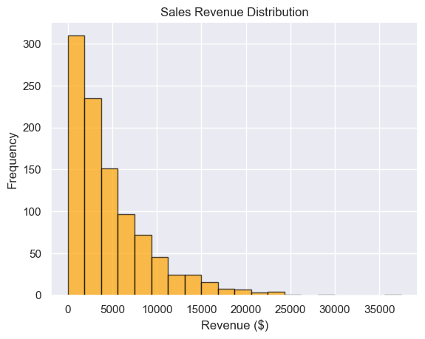
Sales revenue distribution – high end vs low end products

Slide 41
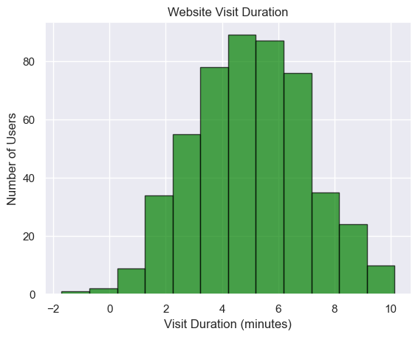
Website visit duration

Slide 42
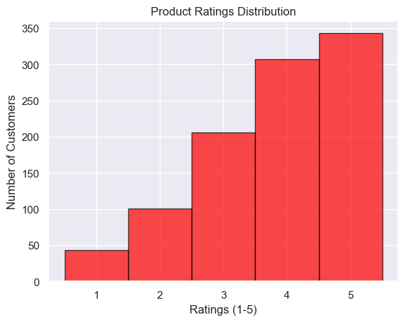
Product ratings

Slide 43
Histogram - distribution of a dataset
# Generate random data
data = np.random.randn(1000) # 1000 random numbers from normal distribution
# Create histogram
plt.hist(data, bins=30, color="purple", edgecolor="black", alpha=0.7)
# Labels and title
plt.xlabel("Value")
plt.ylabel("Frequency")
plt.title("Basic Histogram")
# Show the plot
plt.show()

Slide 44
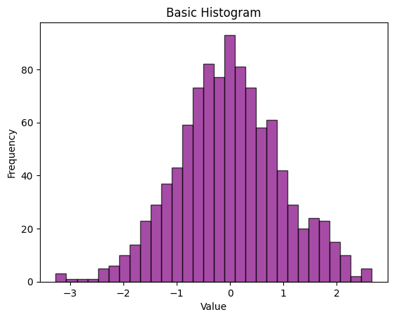
Histogram - distribution of a dataset

Slide 45
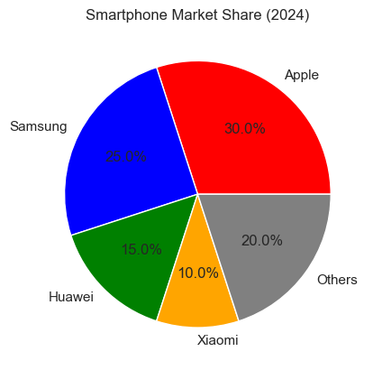
Pie Charts

Slide 46
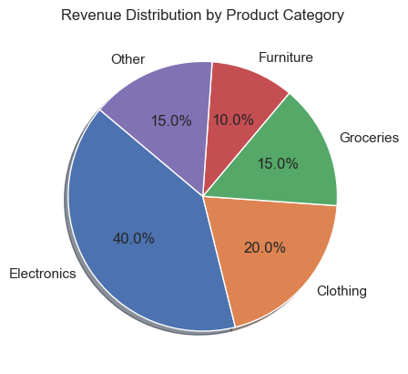
Revenue by product

Slide 47
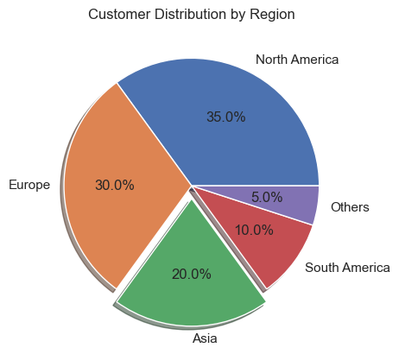
Customer distribution by region

Slide 48
Pie Chart - shows proportions
# Data
labels = ["Apples", "Bananas", "Cherries", "Dates"]
sizes = [30, 25, 35, 10] # Percentage values
# Create pie chart
plt.pie(sizes, labels=labels, autopct="%1.1f%%", colors=["red", "yellow", "purple", "brown"])
# Title
plt.title("Basic Pie Chart")
# Show the plot
plt.show()

Slide 49
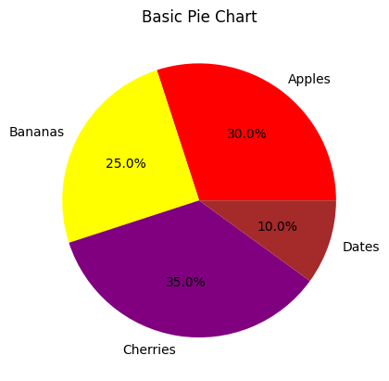
Pie Chart

Slide 50
Exploding a slice
explode = (0, 0.1, 0, 0) # Only "Bananas" slice is pulled out
plt.pie(sizes, labels=labels, explode=explode, autopct="%1.1f%%")

Slide 51
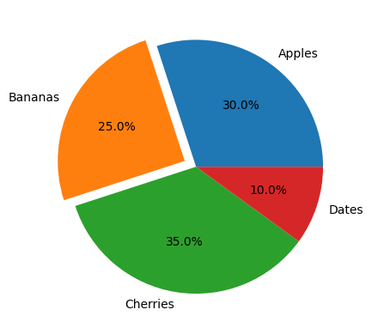

Slide 52
Combining Multiple Plots
# Create a figure with 2 subplots
plt.figure(figsize=(10, 5))
# First subplot (Line Plot)
plt.subplot(1, 2, 1)
x = np.linspace(0, 10, 100)
plt.plot(x, np.sin(x), label="Sine", color="blue")
plt.plot(x, np.cos(x), label="Cosine", color="red")
plt.legend()
plt.title("Line Plot")
# Second subplot (Scatter Plot)
plt.subplot(1, 2, 2)
plt.scatter(np.random.rand(50), np.random.rand(50), color="green")
plt.title("Scatter Plot")
# Show the figure
plt.tight_layout()
plt.show()

Slide 53
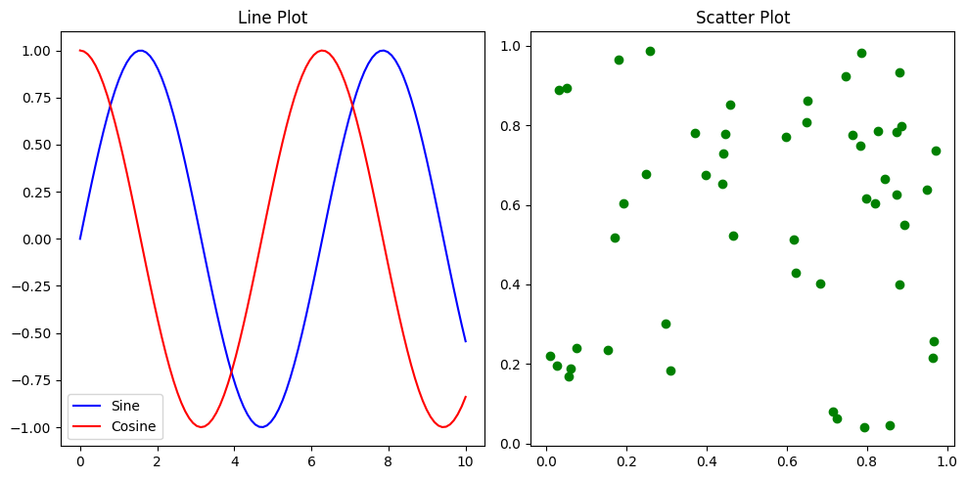
Combining Plots

Slide 54
Saving Plots
plt.plot(x, np.sin(x))
plt.title("Saved Plot")
plt.savefig("plot.png", dpi=300)

